Slide 1
Predicting the Stock Market
How Regression can be Applied to Achieve a Parsimonious Model

Slide 2
objectives
DATA COLLECTION
MODEL SELECTION
INFLUENTIAL DIAGNOSTICS
RESIDUAL DIAGNOSTICS
MULTI-COLLINEARITY
MODEL VALIDATION

Slide 3
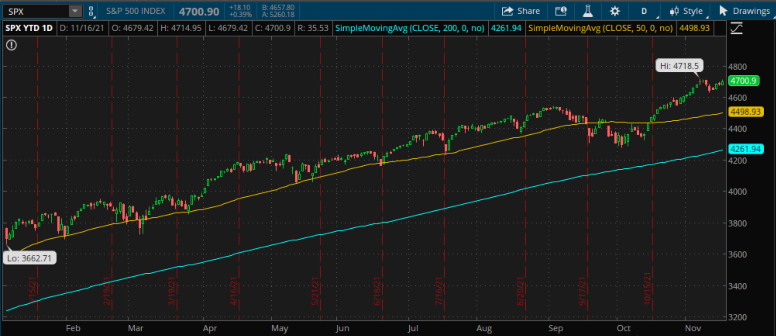
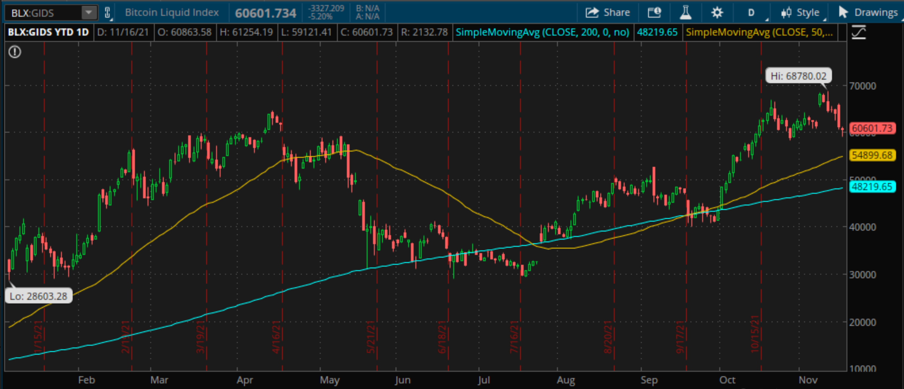

Slide 4
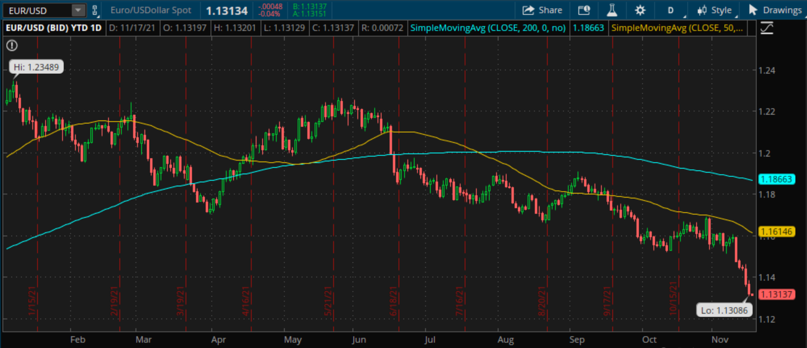
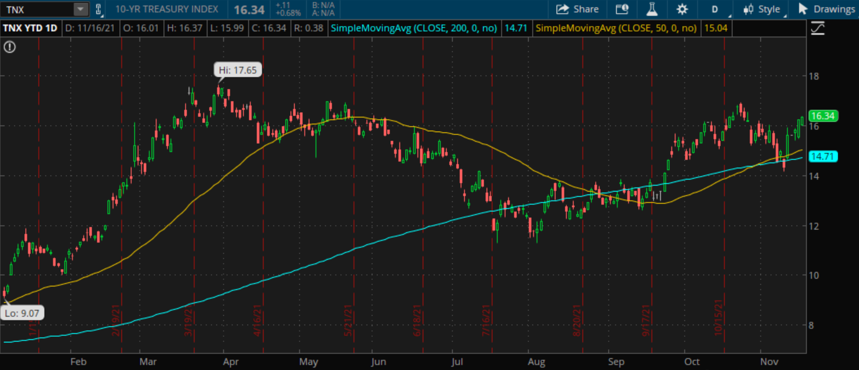

Slide 5
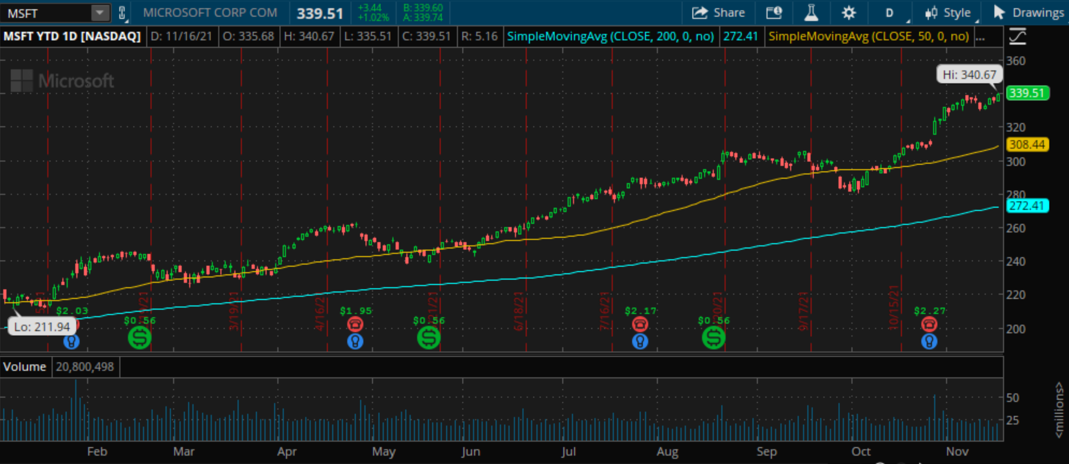
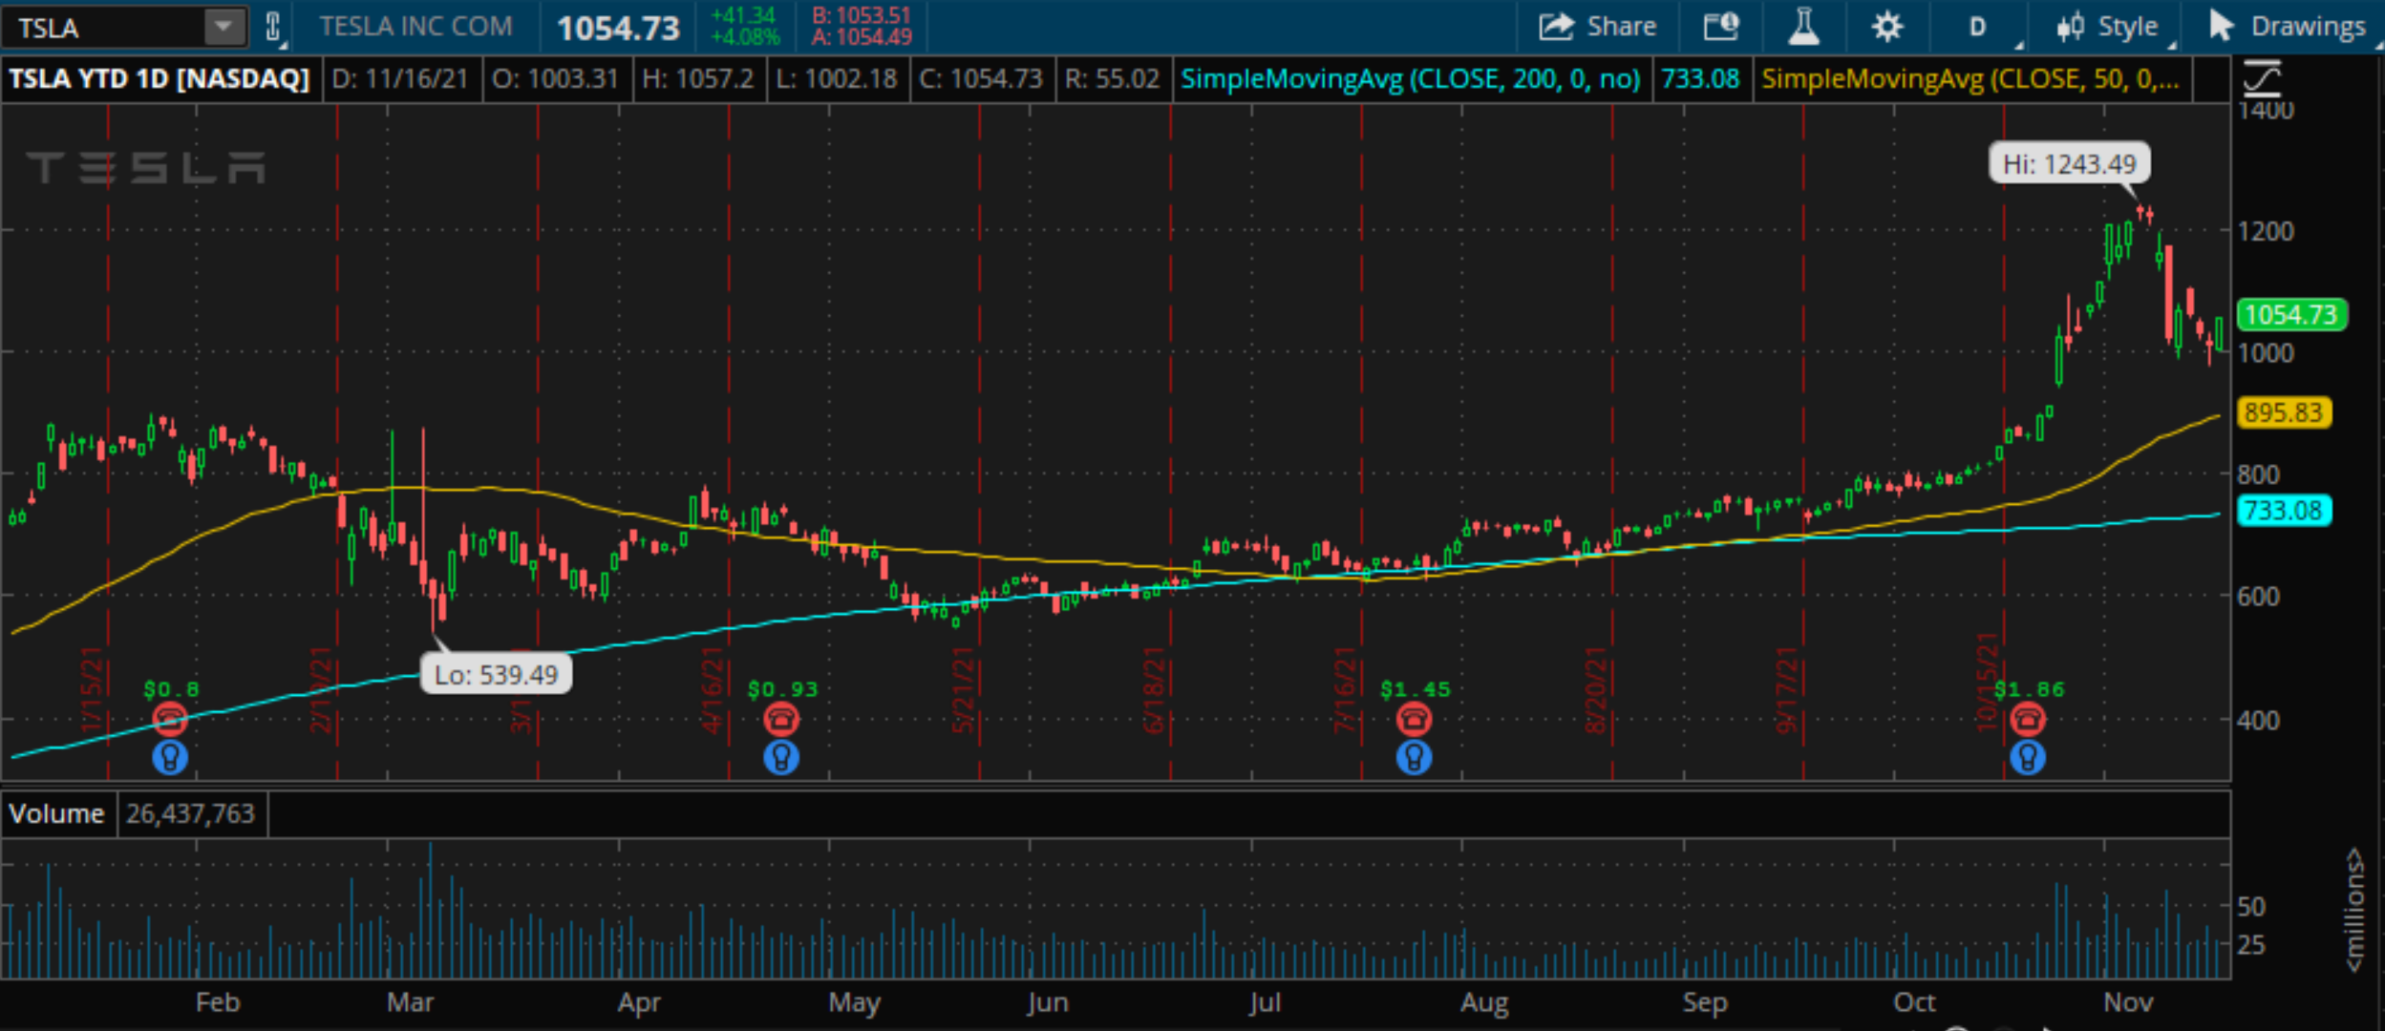

Slide 6
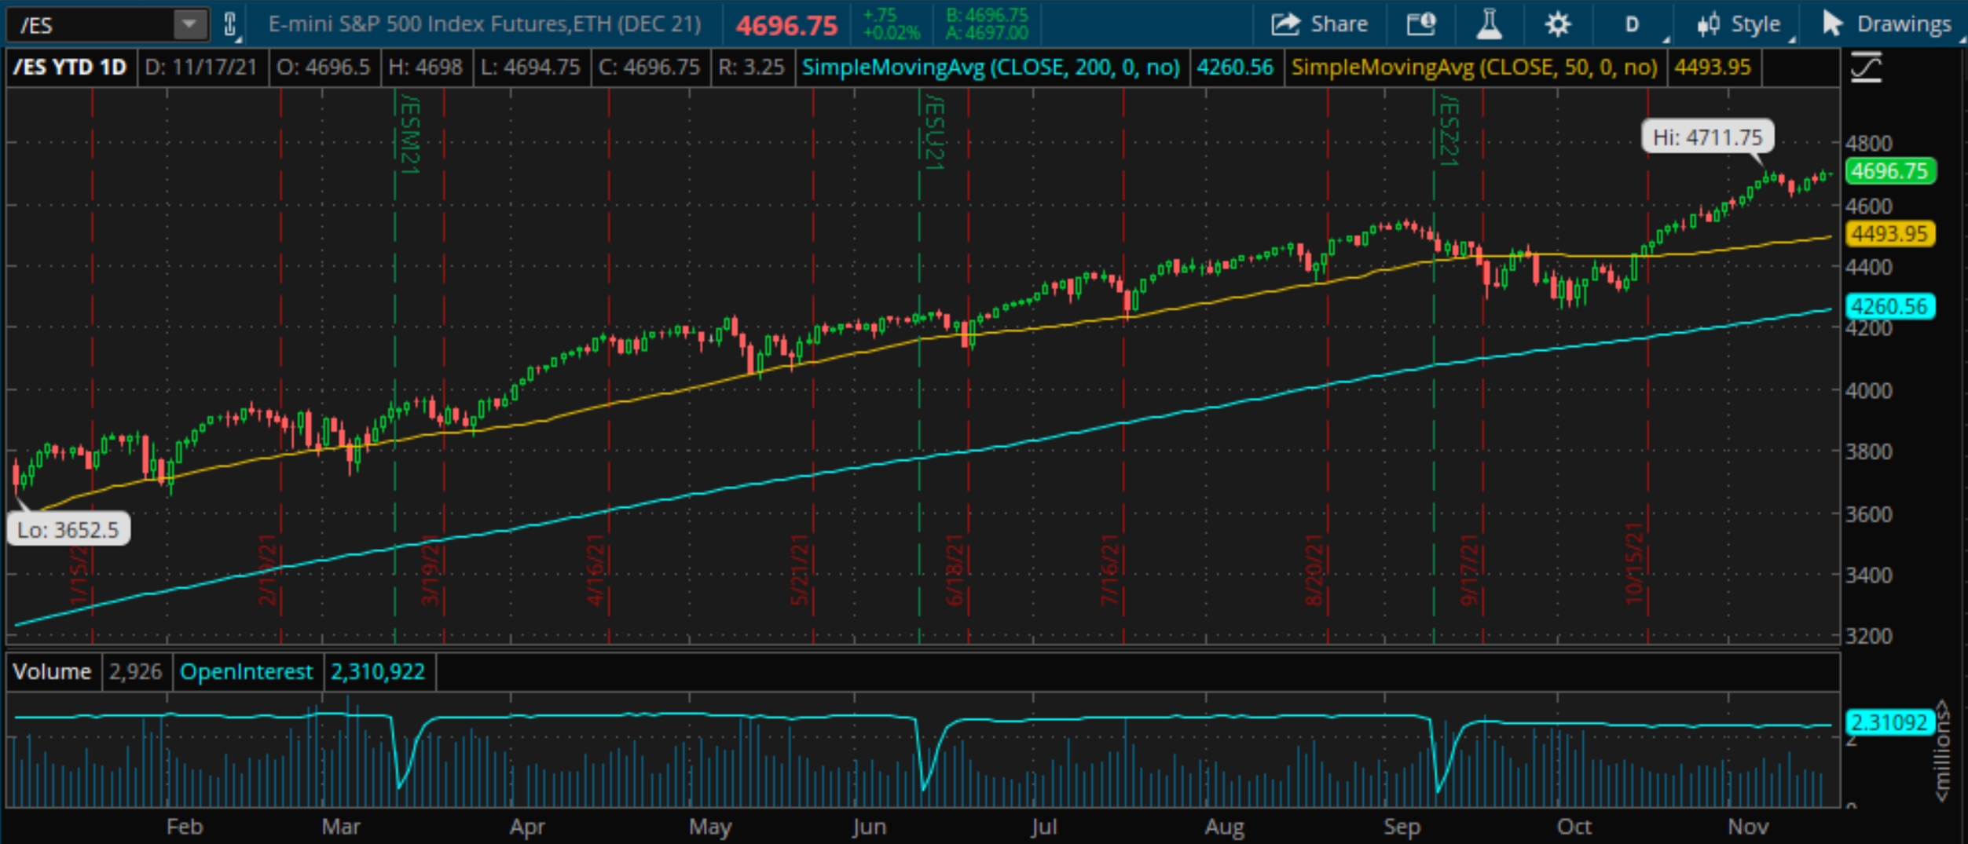
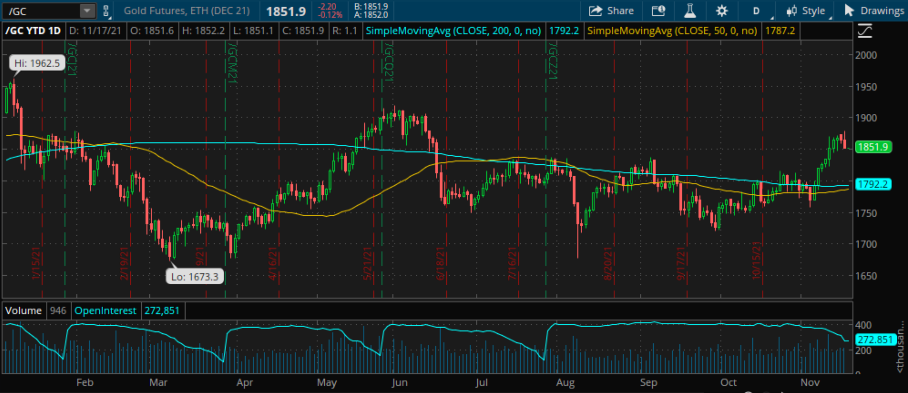

Slide 7
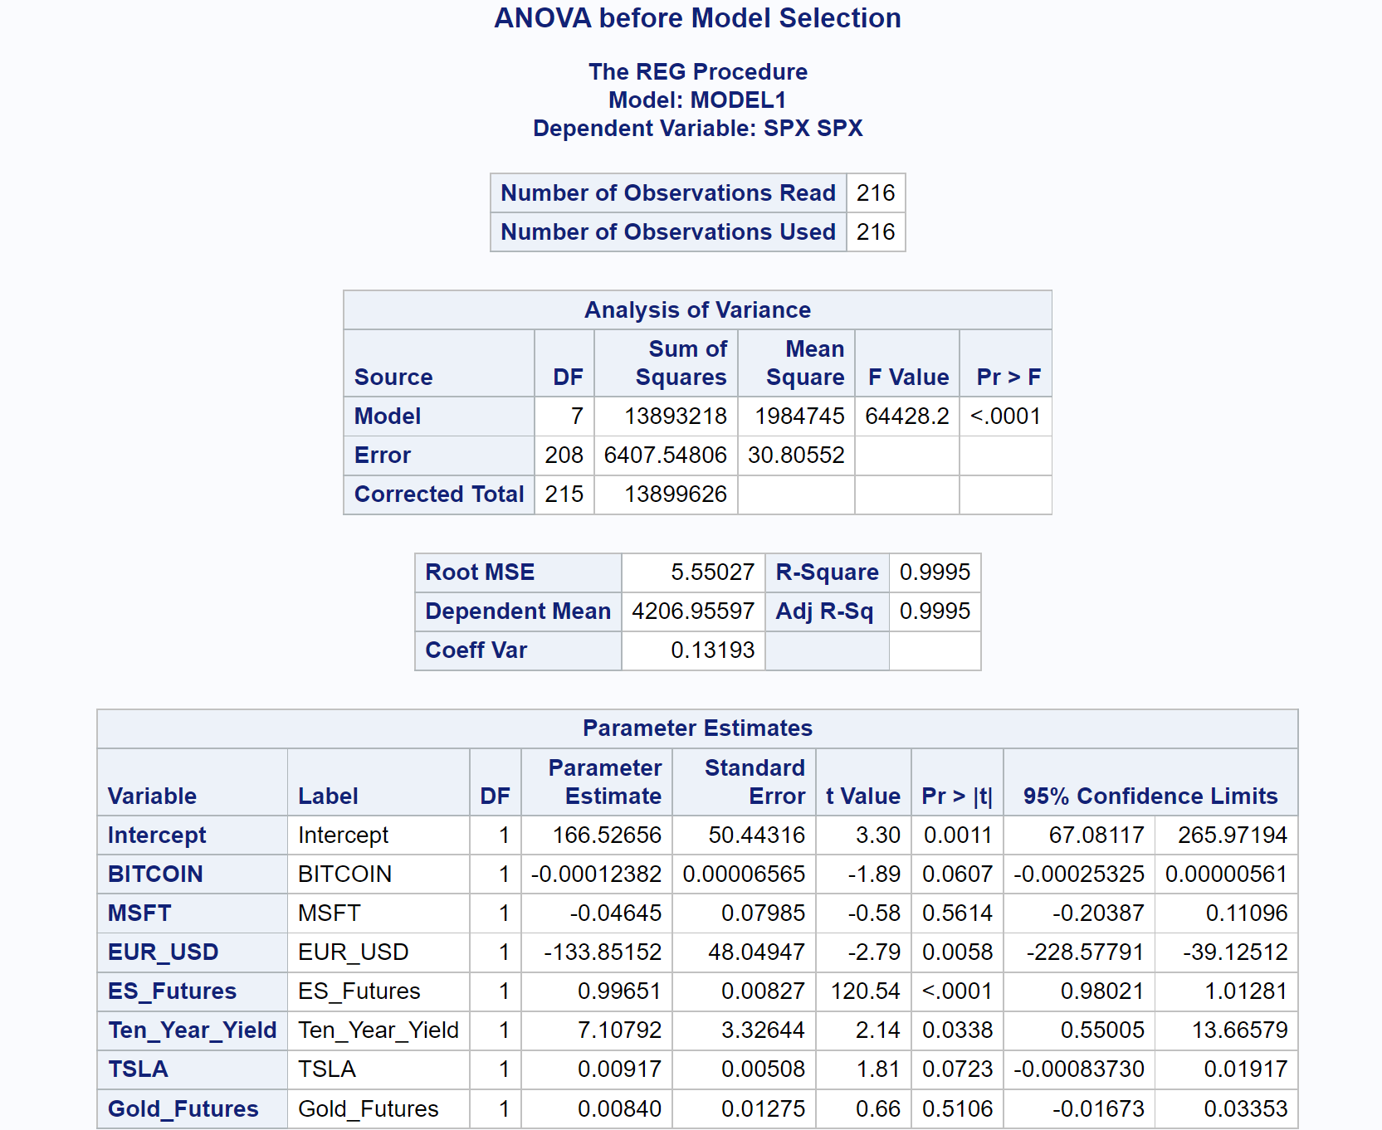
ANOVA using 95% Confidence Level

Slide 8
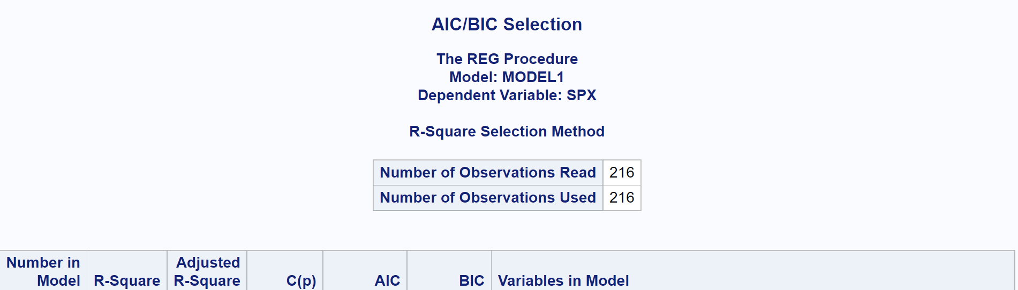

WE FIND 5 predictor VARIABLES USING AIC/BIC

Slide 9
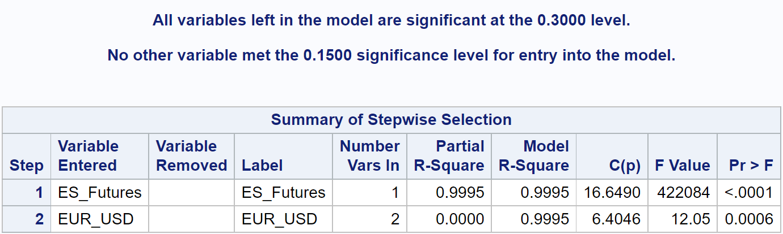
MOST PARSIMONIOUS MODEL USING STEPWISE AUTO-SELECTION

Slide 10
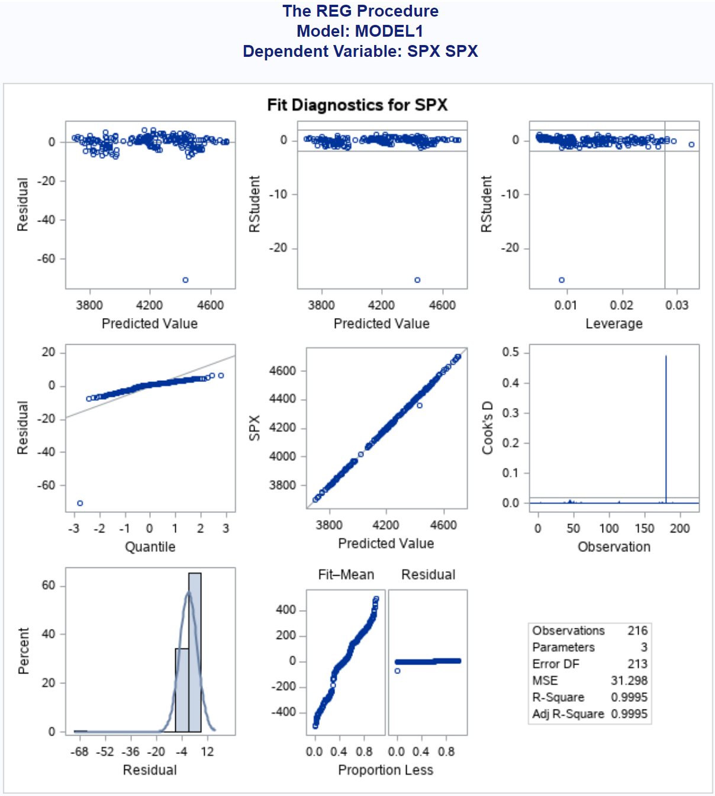
Residual assumptions are not met due to potential outliers

Slide 11
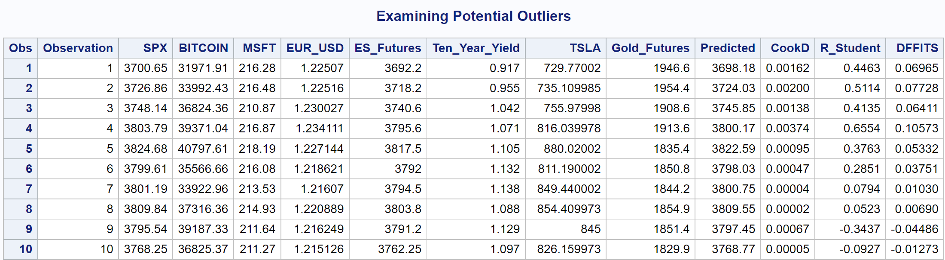
Influential Diagnostics

Slide 12
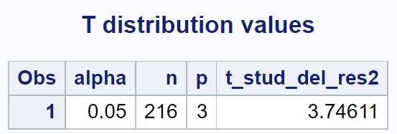


Studentized residual: Bonferroni Adjustment
Rstudent>3.74611 or Rstudent<-3.74611

Slide 13
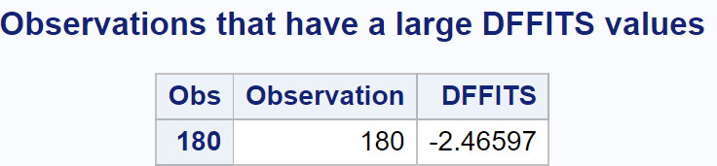
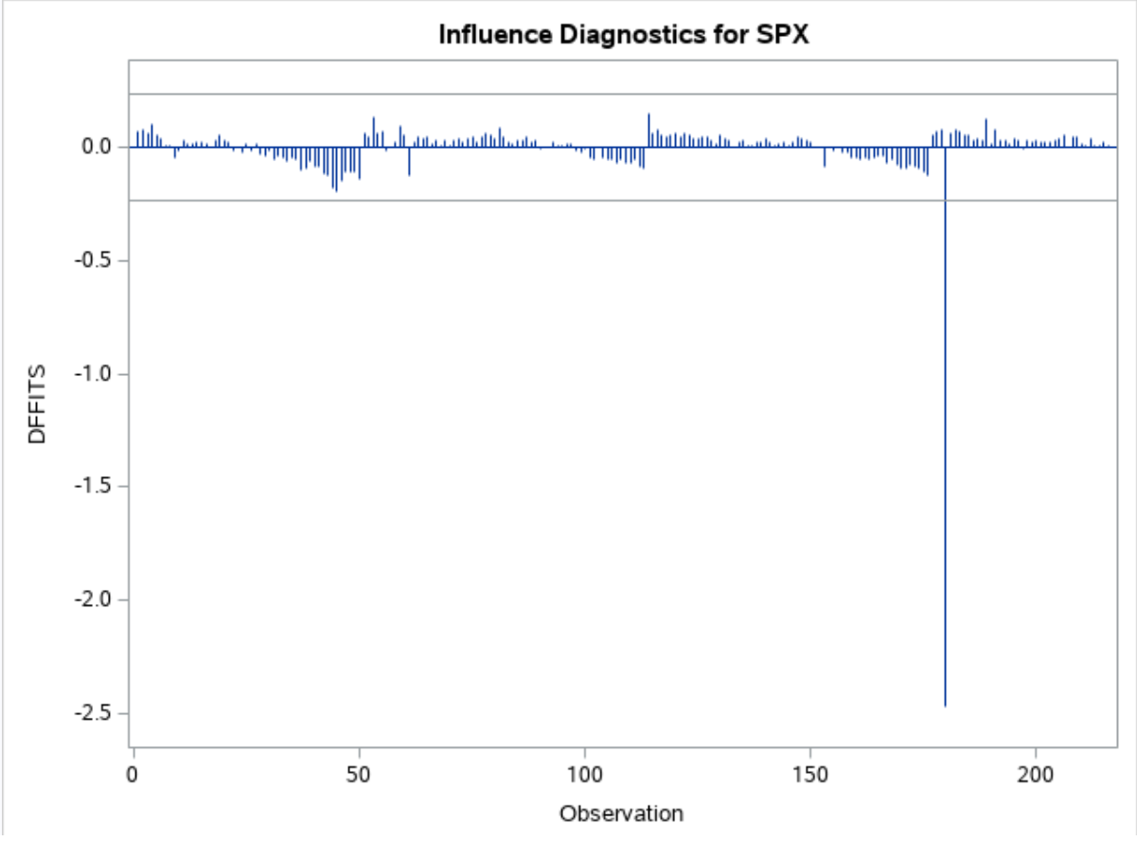
DFFITS OUTLIER
DFFITS>0.2357 or DFFITS<-0.2357

Slide 14
No outliers detected with cook’s d
COOKD>0.7912

Slide 15
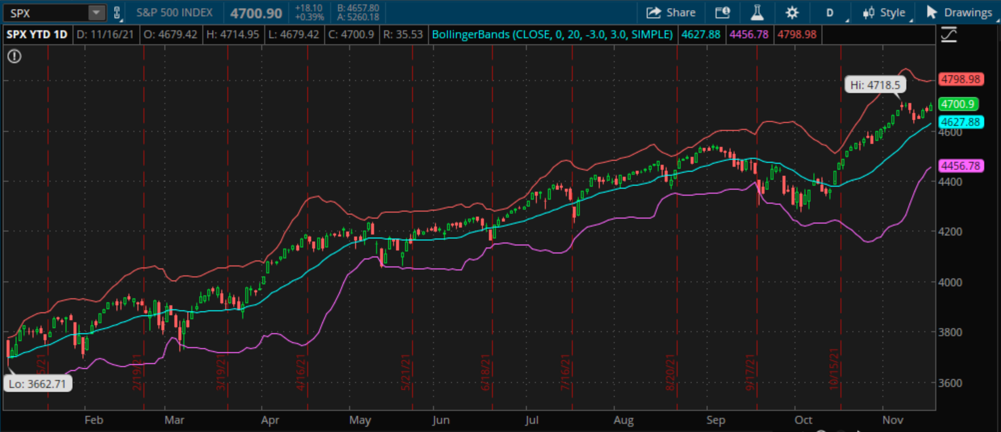
Observation 180 falls outside 3 standard deviations

Slide 16
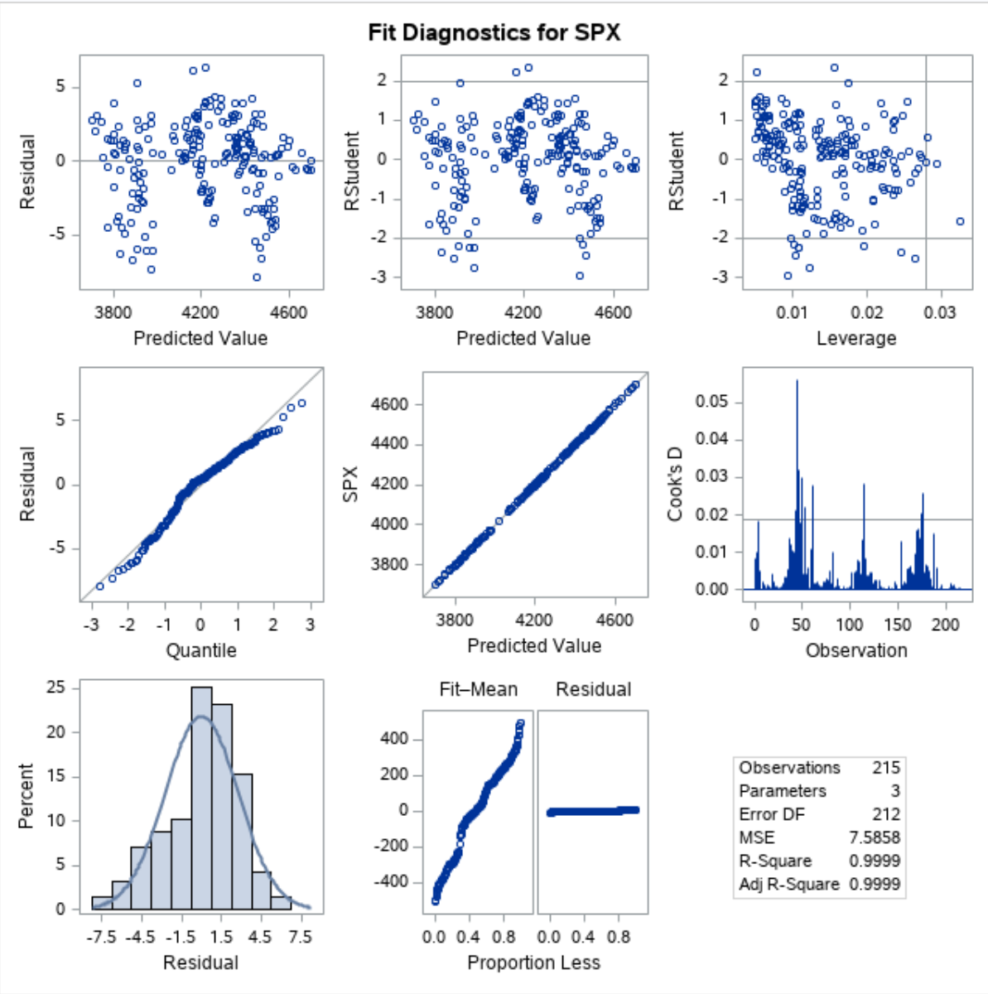
Residual diagnostics corrected
Constancy Assumption Satisfied
Normality Assumption Satisfied

Slide 17
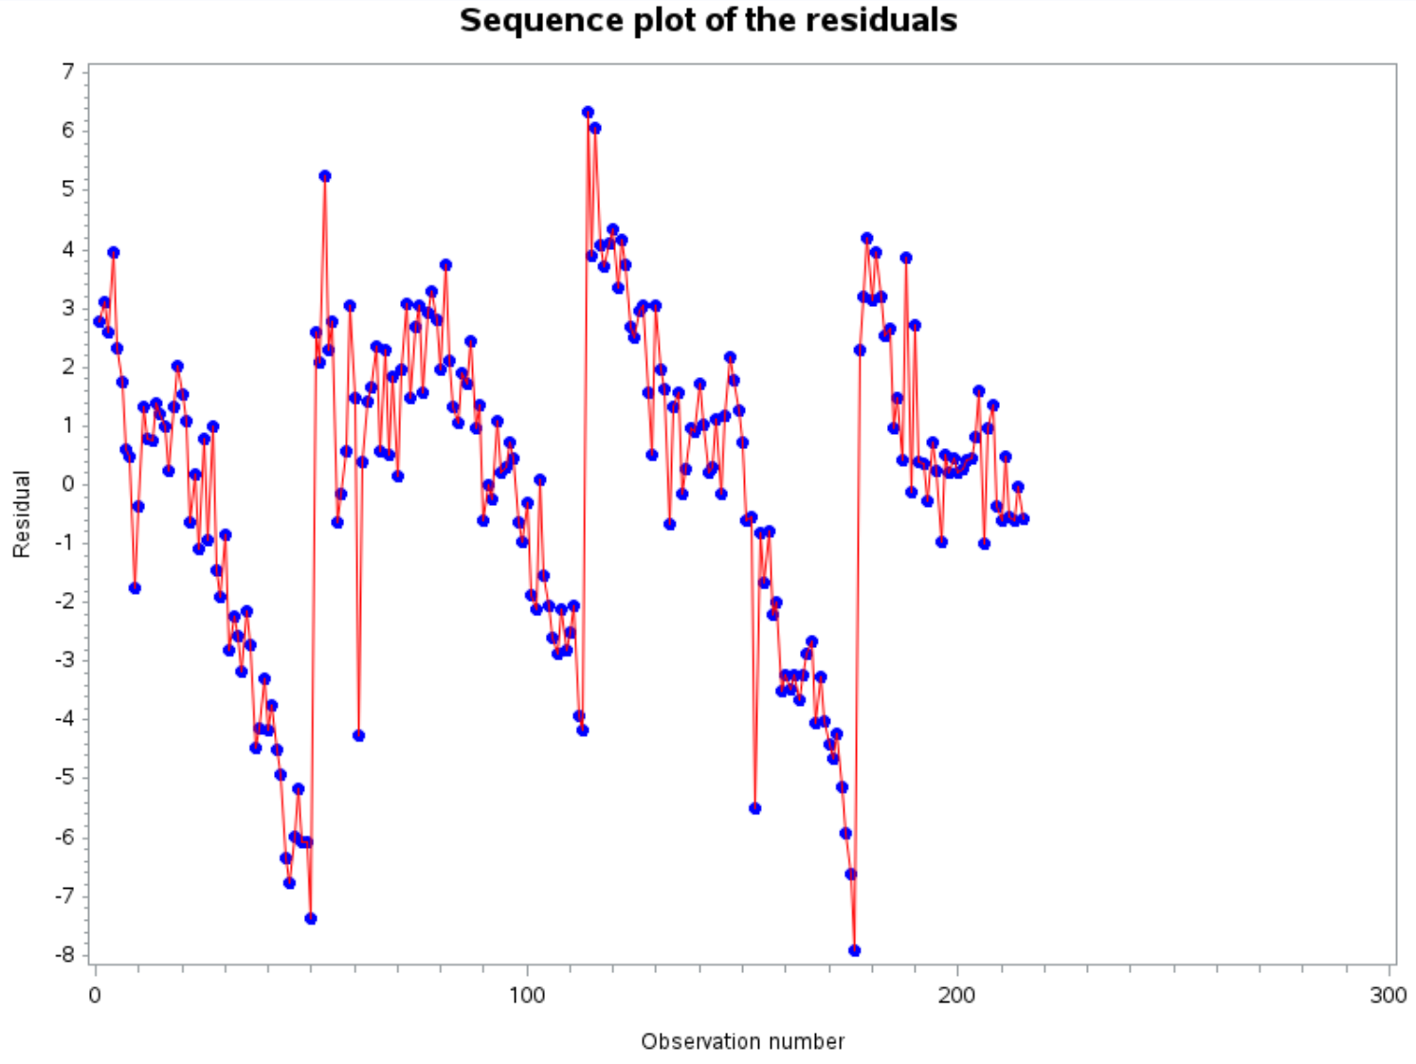
Independence assumption satisfied

Slide 18
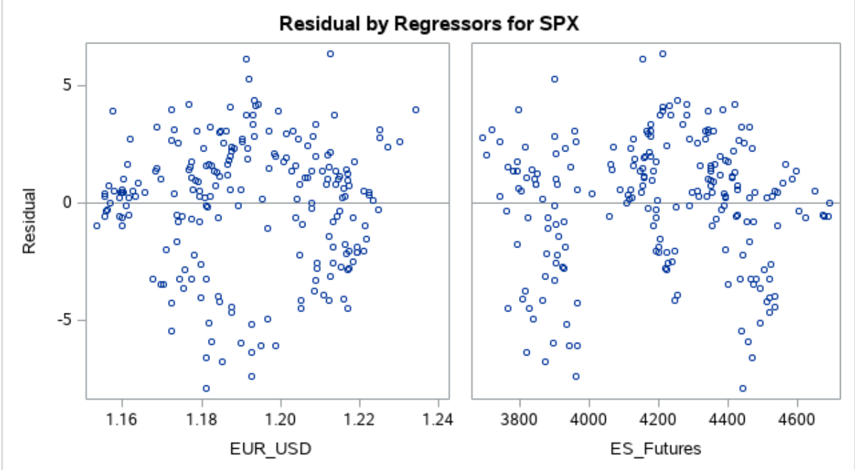

Slide 19
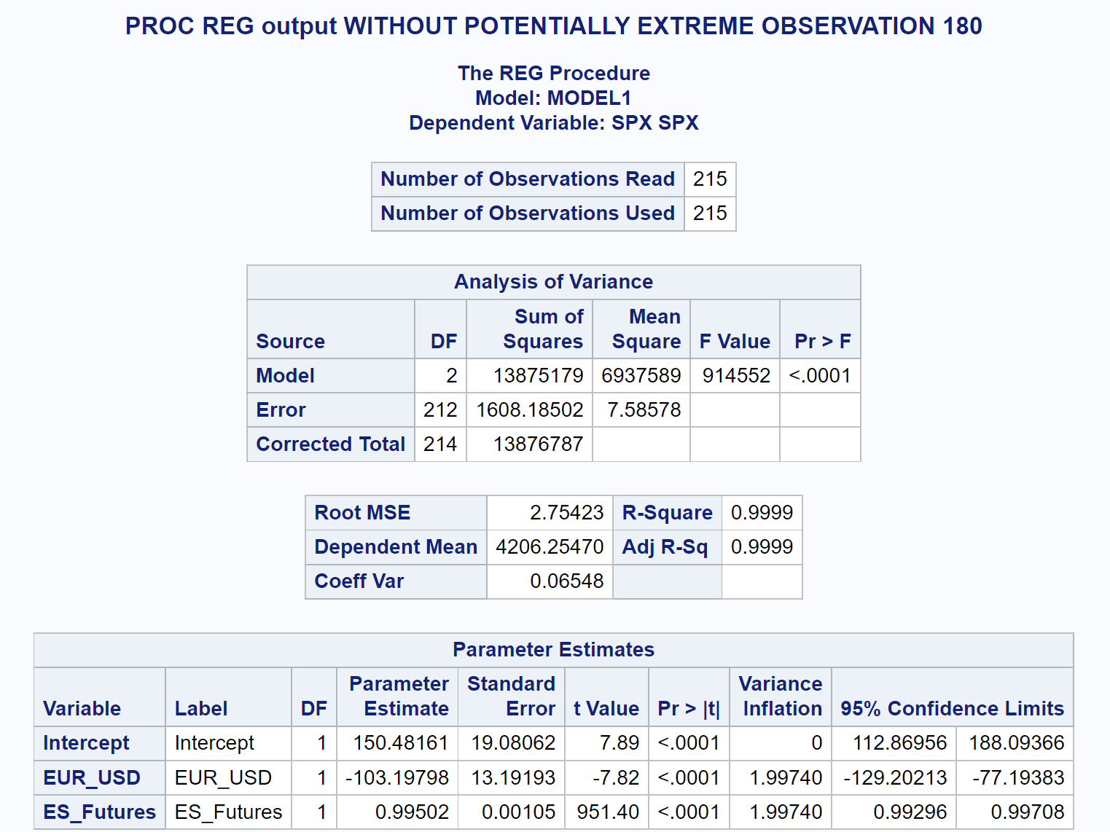
ANOVA without outlier
No Multi-collinearity exists as VIF’s < 10
Adjusted R-Square increased to 0.9999 from 0.9995

Slide 20
Regression Model
Y-Hat = 150.48 – 103.20 * EUR_USD + 0.995 * ES_Futures

Slide 21
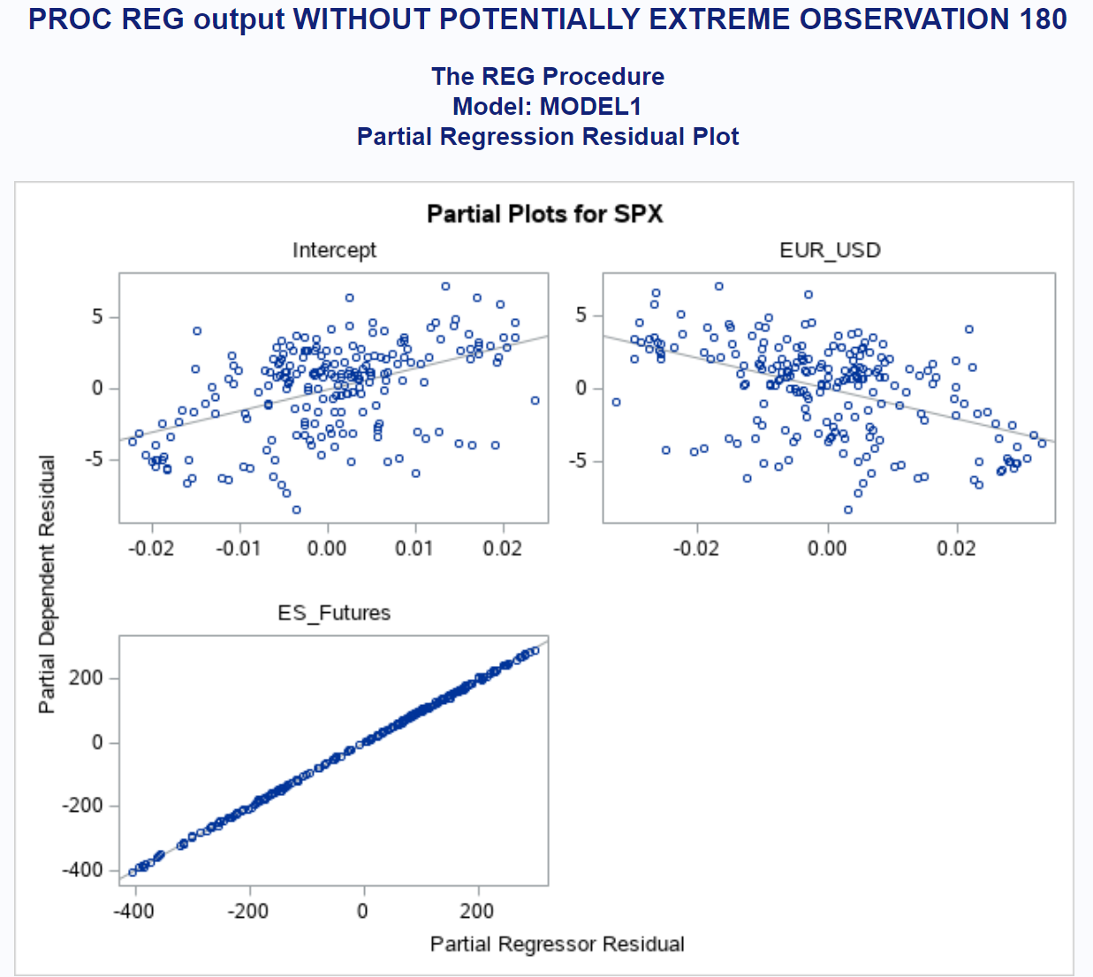
Partial regression plots

Slide 22
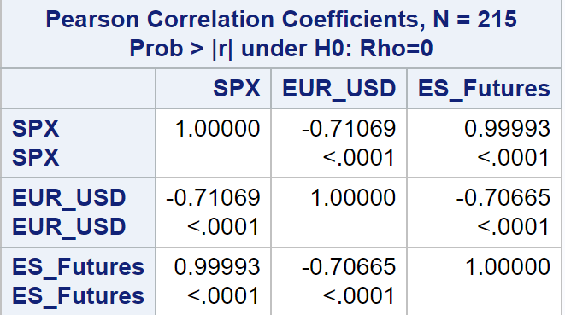
correlation

Slide 23
Model Validation
We want to measure the predictive power of our model on a new data set, or on a partition of our original data and compare against a trained data set
We also want to avoid a model that over-fits our data at the cost of under-fitting new data from the same population

Slide 24
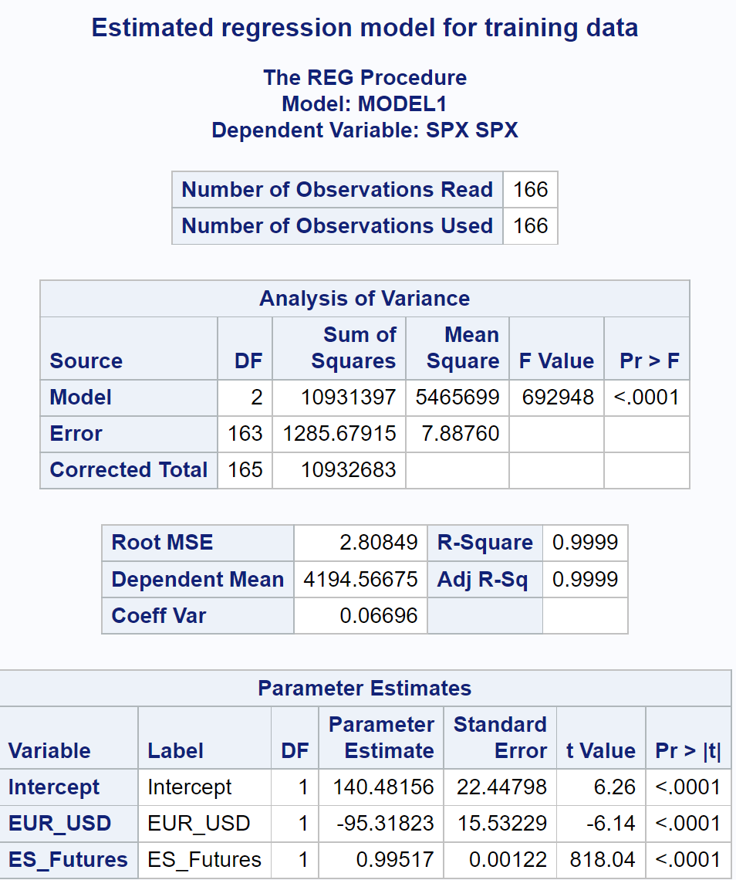
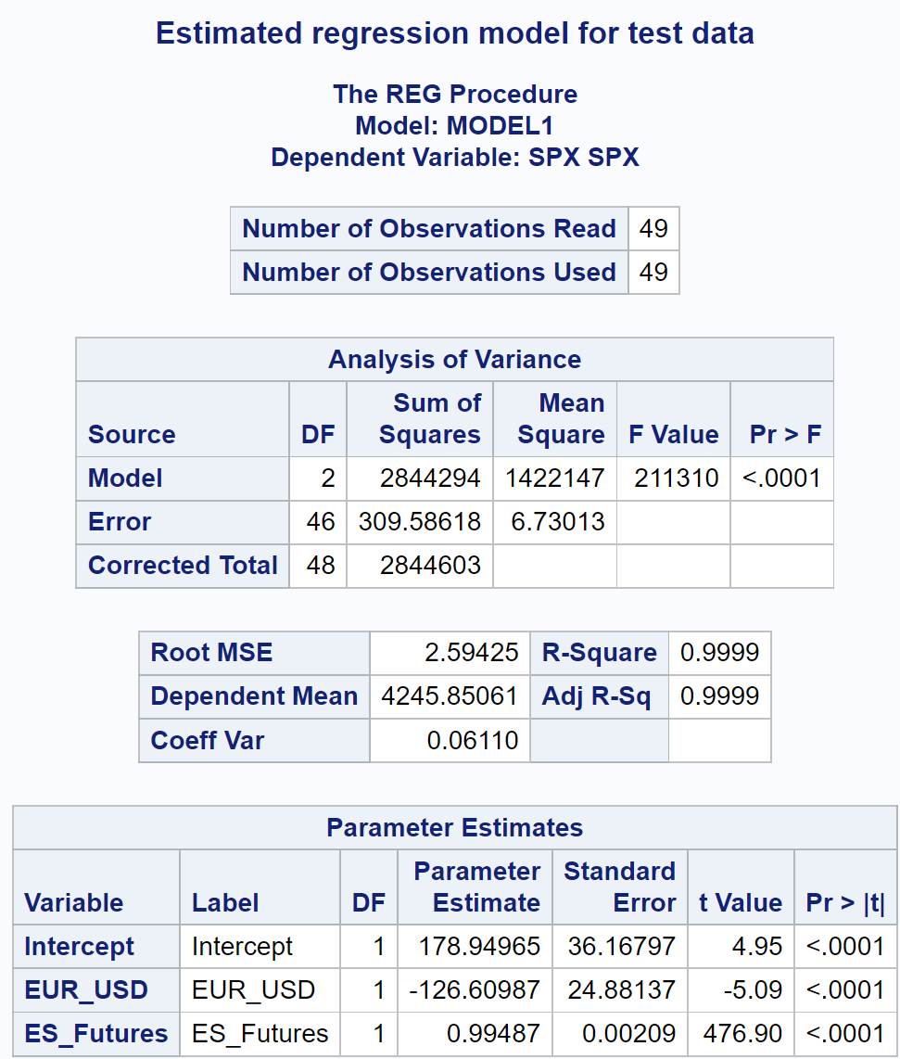

Slide 25
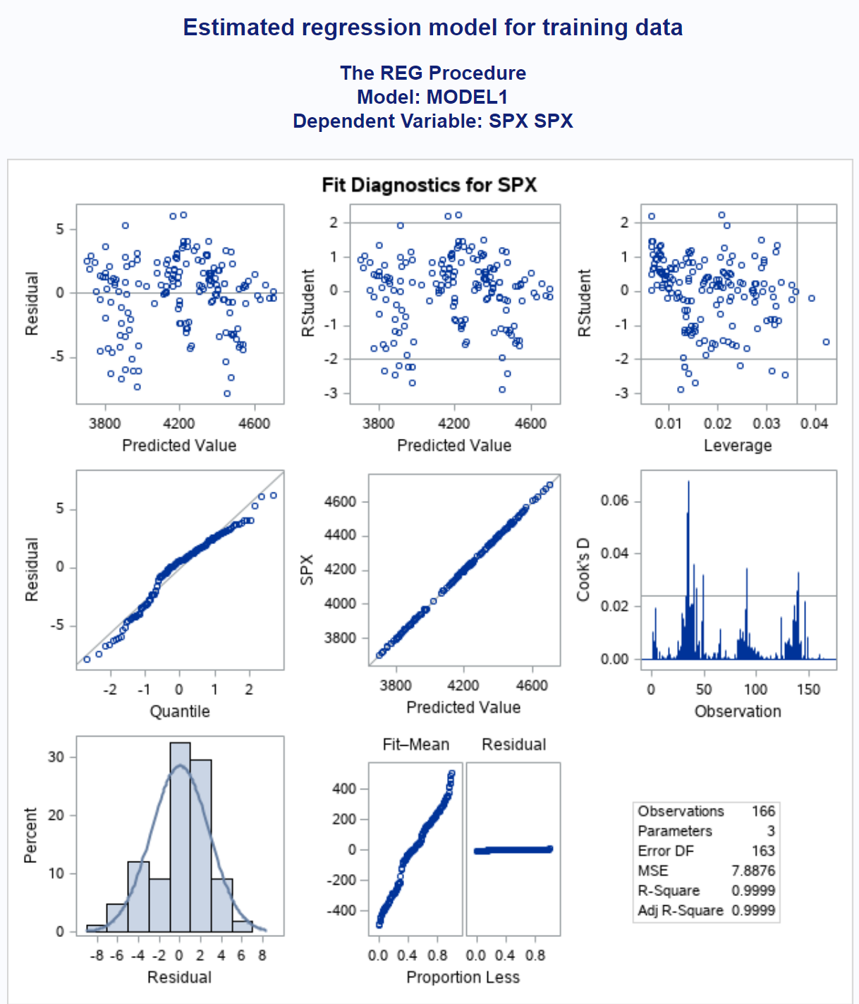
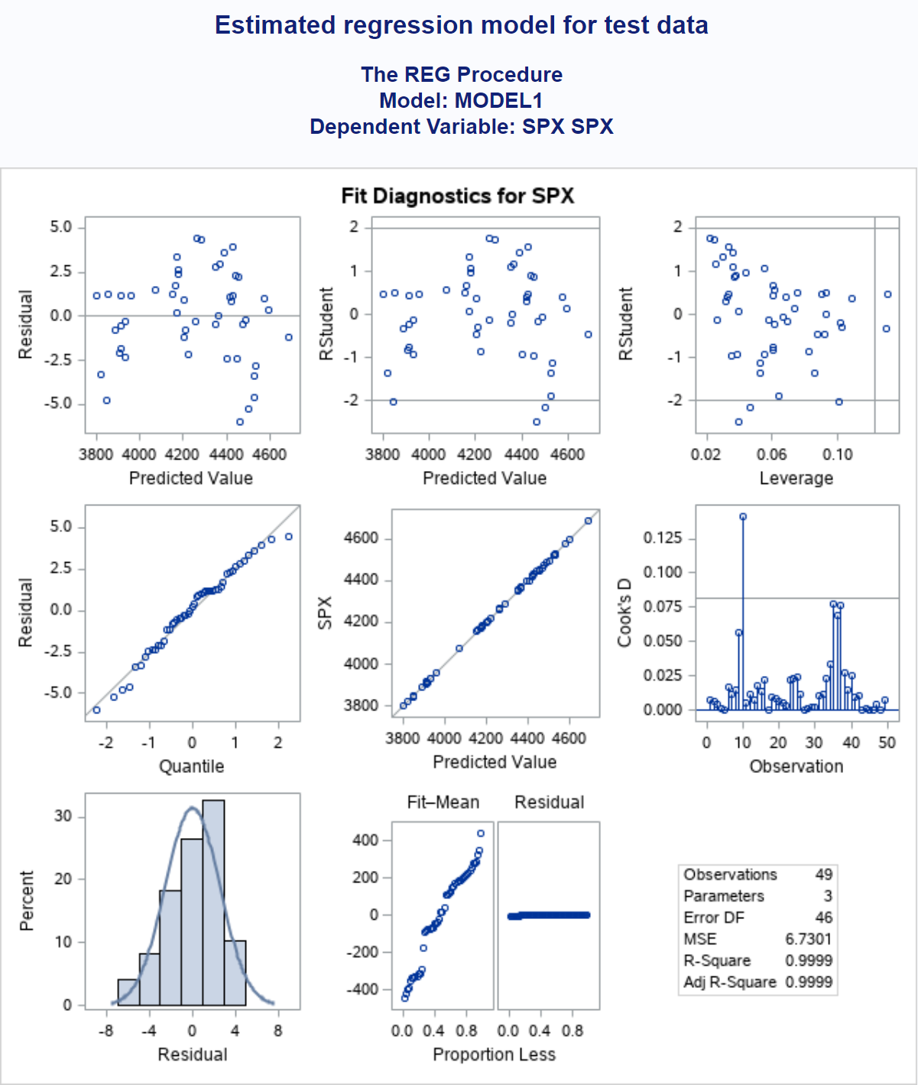

Slide 26
Term | Training | Test | % Change
Intercept | 140.48156 | 178.94965 | 27.3830%
EUR_USD | -95.31823 | -126.60987 | 32.8286%
ES_Futures | 0.99517 | 0.99487 | -0.0301%
Signs are the same for the training and test data sets
Intercept and EUR_USD had the biggest change when we compare the test to the training data

Slide 27
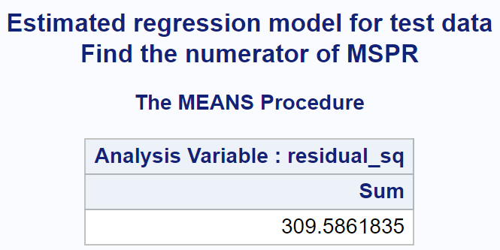
Mean-Squared Prediction ERROR
MSPR = 309.5862 / 49 = 6.3181
MSE from Training data set was 7.8876
Since MSPR and MSE(Training) are close, our model has good predictive power and does not pose the problem of over-fitting

Slide 28

Thank you! Any Questions?

